Slide 1


Forecasting model for sales and production in the field of TMT steel

Slide 2

Project Leadership
Sharat Manikonda
Director at Innodatatics and Sponsor
linkedin.com/in/sharat-chandra

Slide 3

Team Members
Name: M. Satish Kumar
https://www.linkedin.com/in/m-satish-kumar-427023226

Slide 4

Contents
Business objective
Business Constraints
Project Architecture
Data collection and details
Exploratory Data Analysis
Visualization
Modeling
Evaluation
Deployment
Notes:
Change

Slide 5
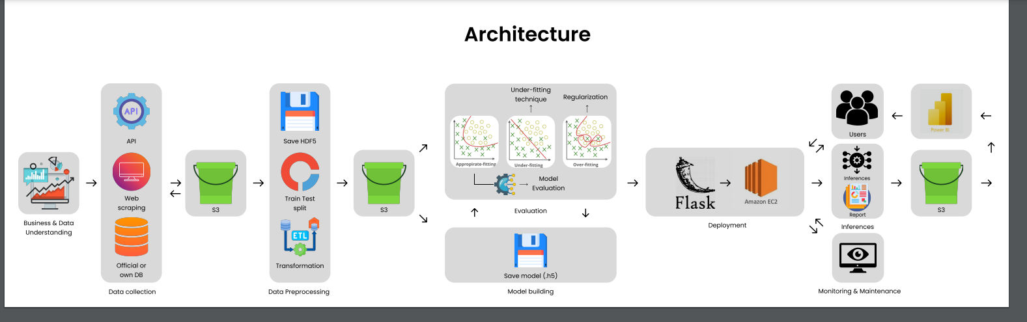
Project Overview and Scope

Slide 6

Business Problem
Offcuts are going unnoticed because of lack of demand of different sizes and diameters of steel rods, leading to increased inventory costs.

Slide 7

Business Objective
Objective
Constraints
Maximize Cost Savings by Minimizing wastage of inventory.
Minimizing manual/gutfeel-based decision making.

Slide 8
There are six stages of CRISP-ML(Q) Methodology:
1. Business and data understanding
2. Data preparation
3. model building
4. Model evaluation
5. Model deployment
6. Monitoring and maintenance
CRISP-ML(Q) Methodology

Slide 9









Technical Stacks
Language :
IDE :
Libraries :
Web-Frame :

Slide 10

Data Collection and Understanding
The data which we've collected is directly from the client. This dataset is related to TMT steel industry. which is dealing with the production and distribution of steel products, navigates the market with a diverse range of diameters, grades, and lengths.
We've got the data in CSV format, consisting of 12 columns with 33045 rows. The columns are related to various aspects of the TMT steel production and distribution process, such as product specifications, quantities, rates, and values, which are crucial for analysis and decision-making.
The data will be applied for forecasting objectives, involving the training and validation of a predictive model through the utilization of machine learning techniques. This approach aims to facilitate accurate predictions and well-informed decisions.

Slide 11
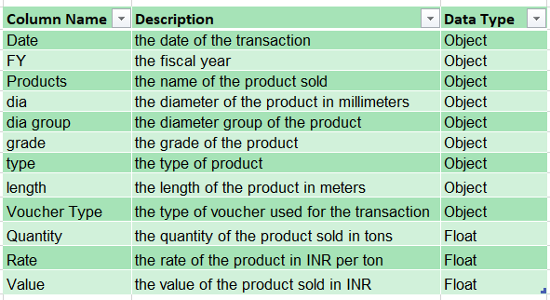
Data Dictionary

Slide 12

System Requirements
General prerequisites
Numerical & Categorical data.
Installing required libraries in the system.
For the fastest performance run it on GPU
System Requirements
Memory: 8GB
Graphics Card: NVIDIA GeForce 940MX / AMD Radeon RX 480
CPU: Intel Core i5
OS: Windows 8.1

Slide 13

Exploratory Data Analysis [EDA]
Exploratory Data Analysis (EDA) is a foundational technique for understanding data sets. By unveiling patterns and relationships, EDA sets the stage for further analysis. It encompasses visualization, stats, and data cleaning to transform raw data into insights. EDA is iterative, refining understanding as it progresses.
EDA employs visualization tools like histograms and scatter plots to reveal data distributions and outliers. Statistical analysis offers quantitative insights into central tendencies and variabilities. Data cleaning ensures accuracy by addressing inconsistencies and anomalies. As patterns emerge, EDA refines data exploration and guides subsequent analysis.
Notes:
EDA is used for seeing what the data can tell us before the modeling task.
Change

Slide 14
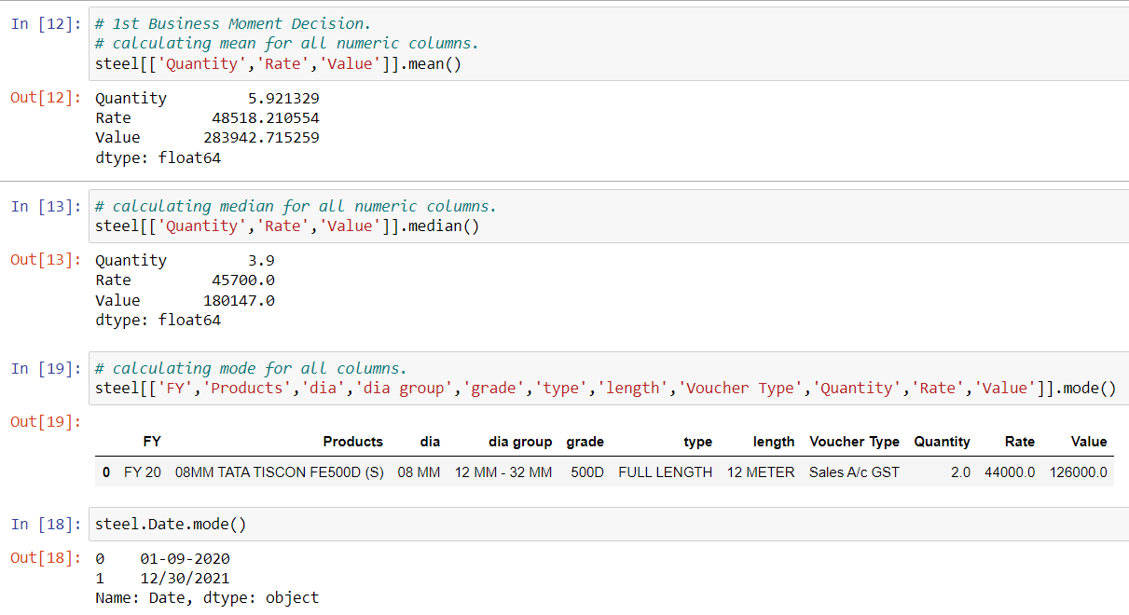
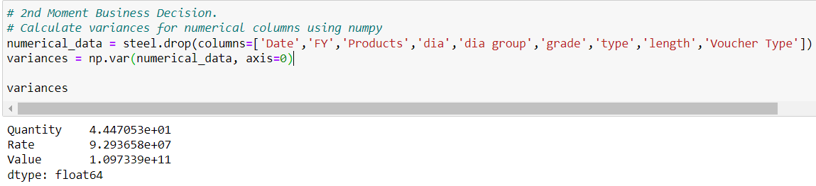
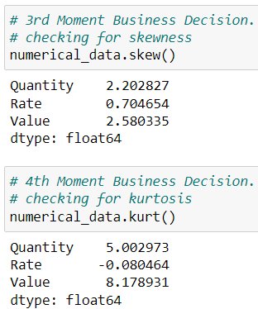
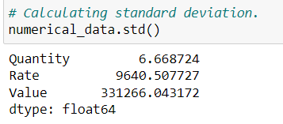
Exploratory Data Analysis [EDA]
During the EDA phase, we will engage in several processes. We will systematically address all four key business moments, accompanied by graphical illustrations.

Slide 15

Data Preprocessing
In the presence of missing values, the strategy entails applying pertinent techniques to handle them. Numerical values are addressed through Mean and Median Simple Imputer, while categorical data is treated using the Mode Imputer. Alongside, any duplicated entries are excluded from the dataset during the preprocessing phase.
In our dataset, we found 66 duplicates, we used "drop_duplicates()" function to drop them.
No missing values were found in our dataset.
Next, the dataset undergoes outlier treatment when outliers are identified. The application of Winsorization with diverse capping methods further contributes to addressing these anomalies.
Notes:
Keep observations

Slide 16
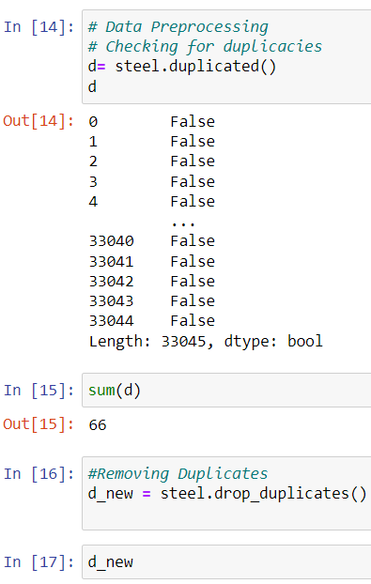
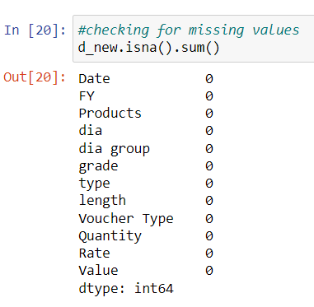
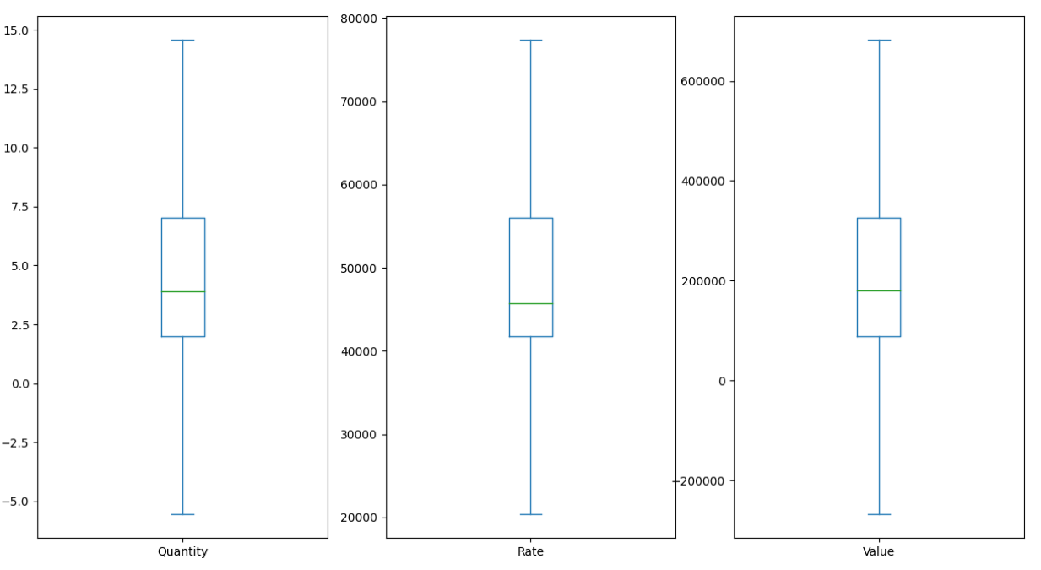
Result of Data Preprocessing
Treating duplicates
Checking missing values
Outlier Treatment

Slide 17
Data Visualization
Graphical Representation
Visualizing our dataset is one of the best ways to understand trend in our dataset, especially when we are dealing with large datasets.
Matplotlib and Seaborn are popular python libraries that can be used to create our data visualizations easily.
Visualizing our dataset helps us in understanding the trend, patterns and outliers within large dataset, it also helps in us to identify the correlations or the relationship between the independent variables.
For Better visualizations, I have used PowerBI. Hence following are the representations, with some of the important insights
Notes:
Add graphical

Slide 18
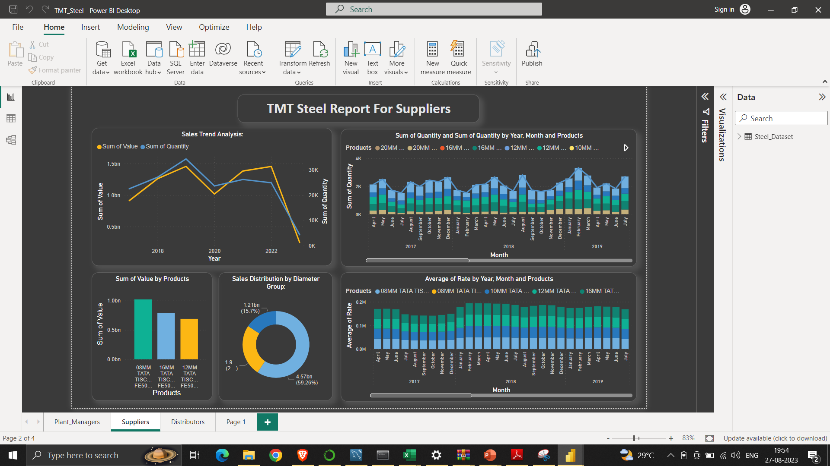
Data Visualization

Slide 19
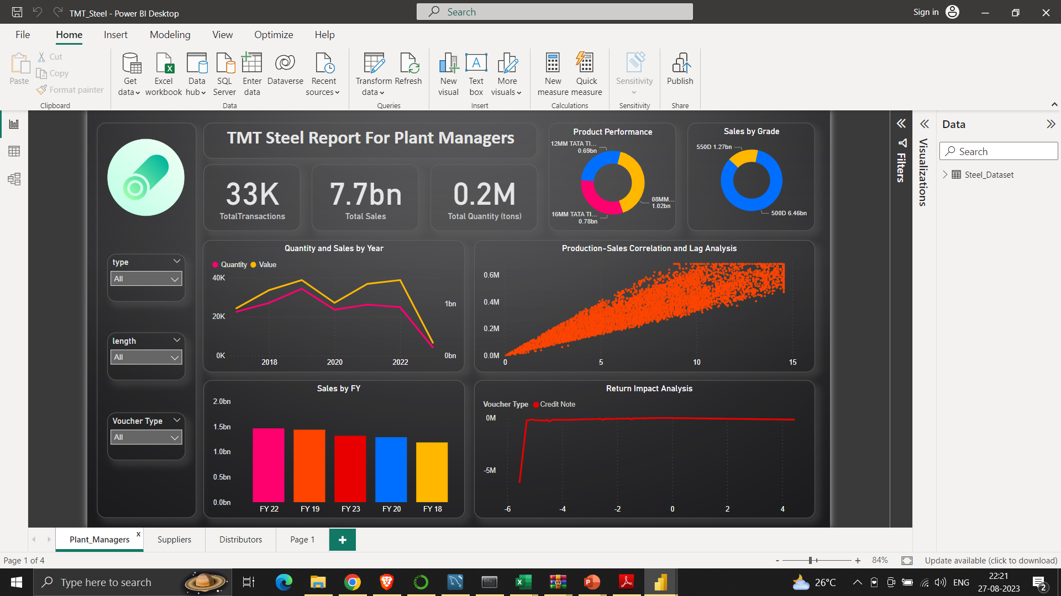
Data Visualization

Slide 20
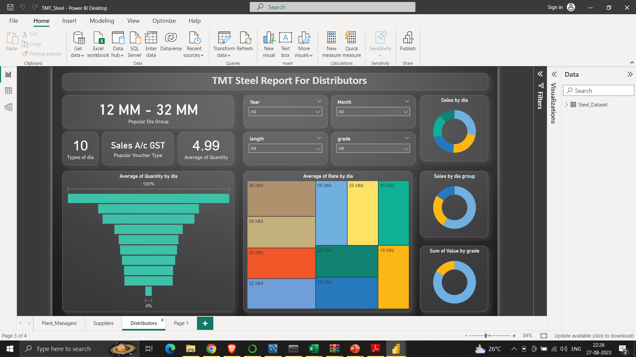
Data Visualization

Slide 21
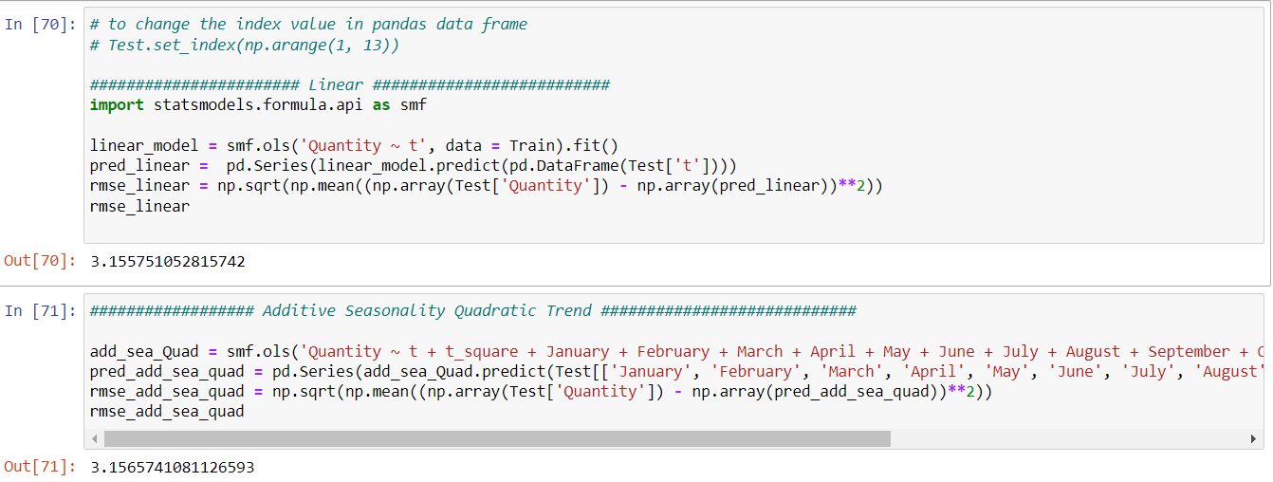
Model Building
Model Based Approach
A model-based forecasting approach involves using mathematical, statistical, or machine learning models to predict future values based on historical data patterns. These models capture relationships, trends, and patterns within the data and then extrapolate this information to make predictions about what might happen in the future.
Notes:
classification is the task of predicting a discrete class label. Regression is the task of predicting a continuous quantity.
What is classification techniques in machine learning?
The Classification algorithm is a Supervised Learning technique that is used to identify the category of new observations on the basis of training data. In Classification, a program learns from the given dataset or observations and then classifies new observation into several classes or groups.
What is regression techniques in machine learning?
Regression is a technique for investigating the relationship between independent variables or features and a dependent variable or outcome. It's used as a method for predictive modeling in machine learning, in which an algorithm is used to predict continuous outcomes.

Slide 22
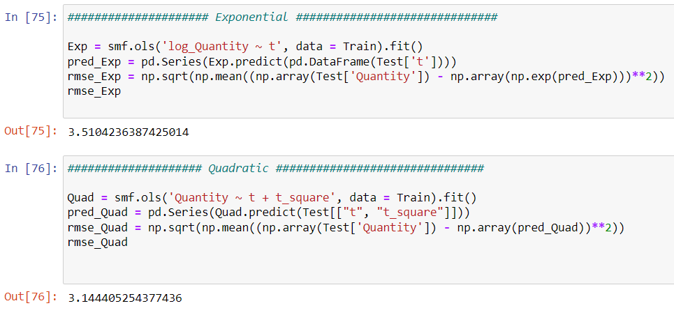
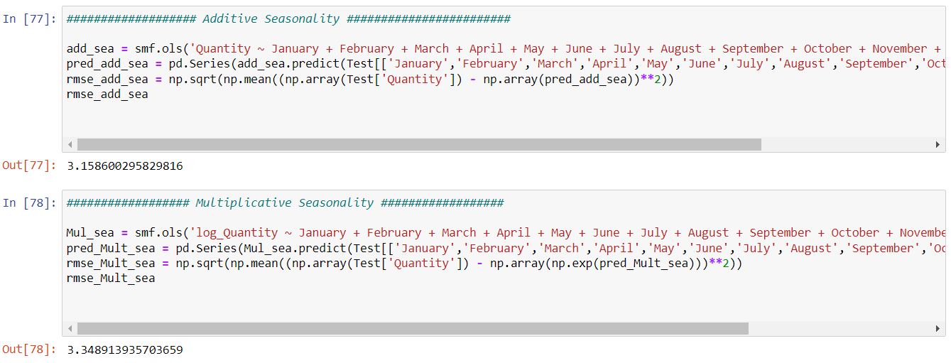
Model Building

Slide 23
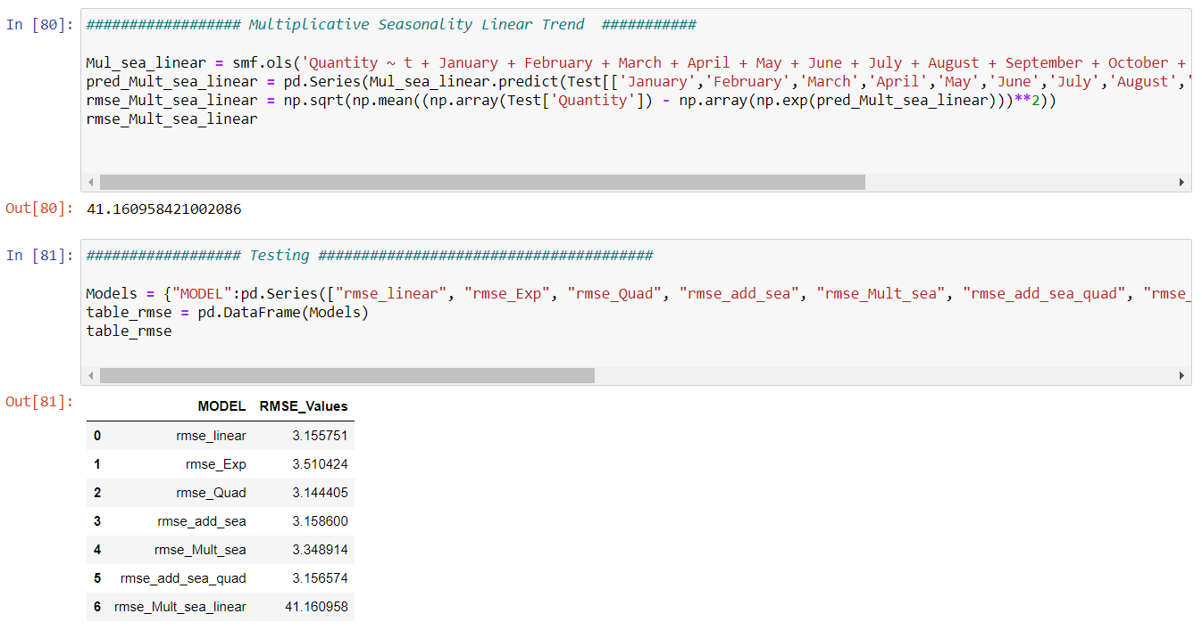
Model Building

Slide 24
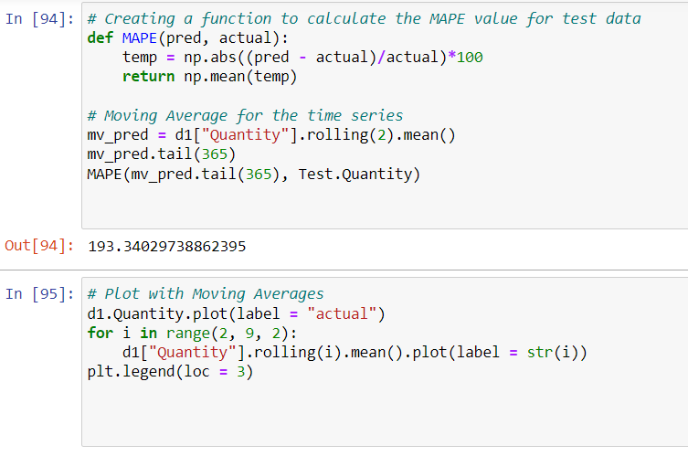
Model Building
Data - Driven Approach
A data-driven approach in machine learning involves deriving insights and making decisions primarily based on patterns and information present in the data itself.
Instead of relying heavily on pre-defined rules or assumptions, a data-driven approach allows the model to learn directly from the data and adapt to its intricacies.

Slide 25
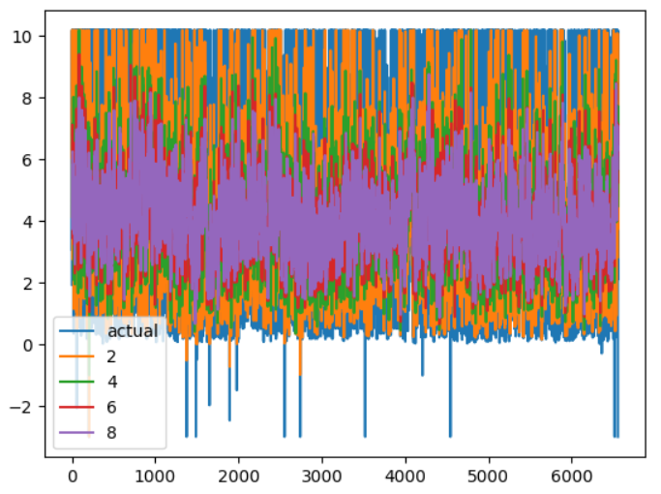
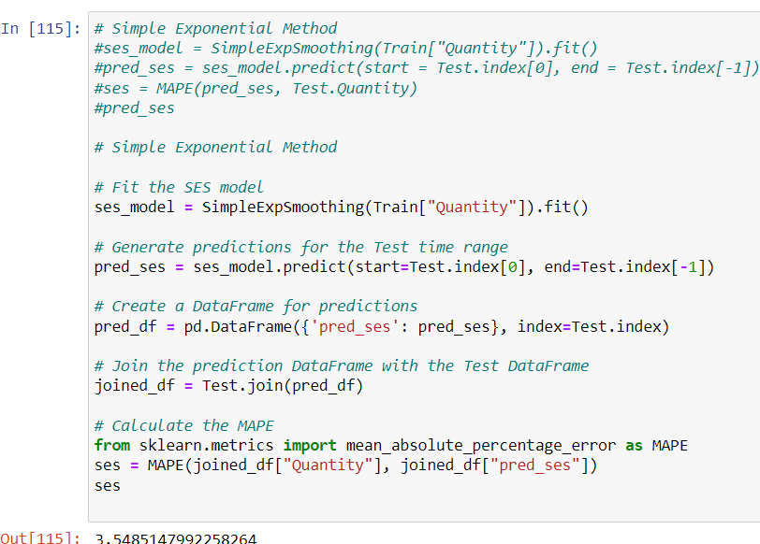
Model Building

Slide 26
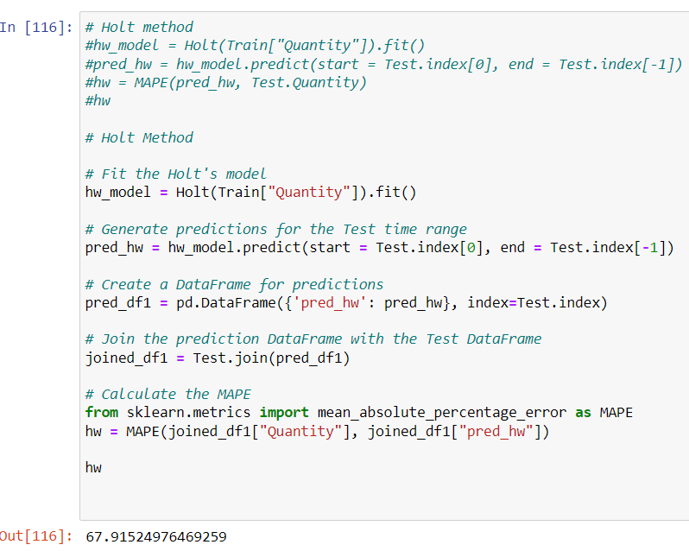
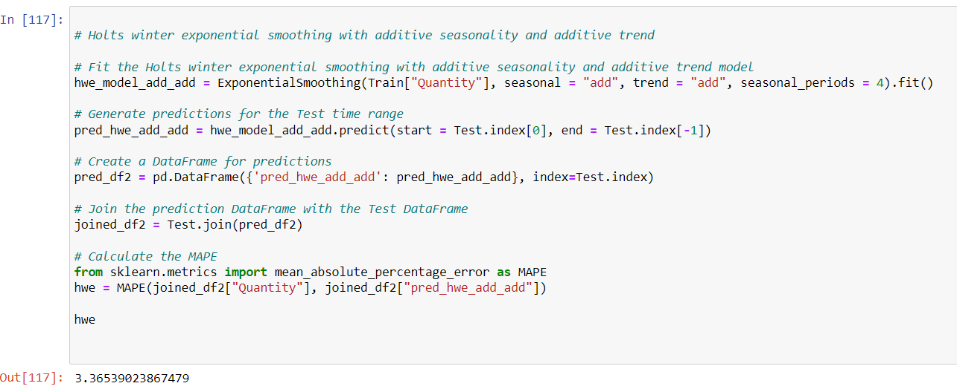
Model Building

Slide 27
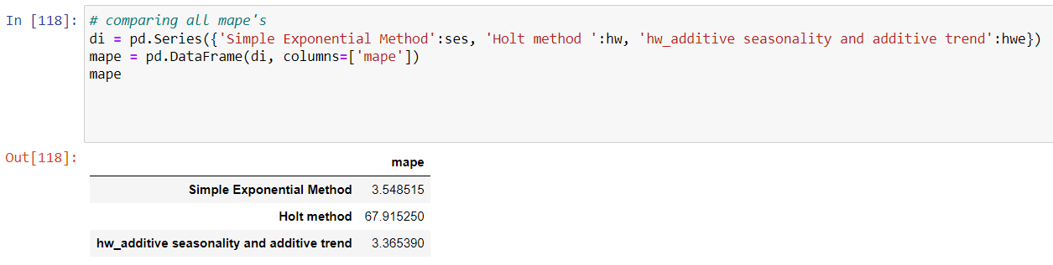
Model Building

Slide 28
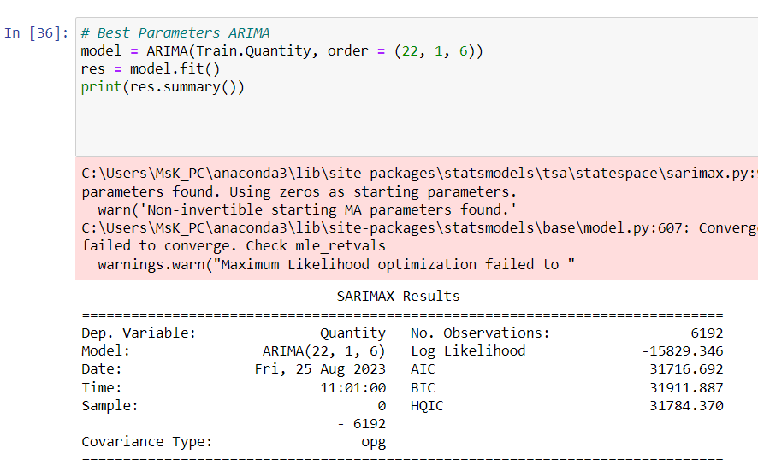
Model Building
ARIMA Model

Slide 29
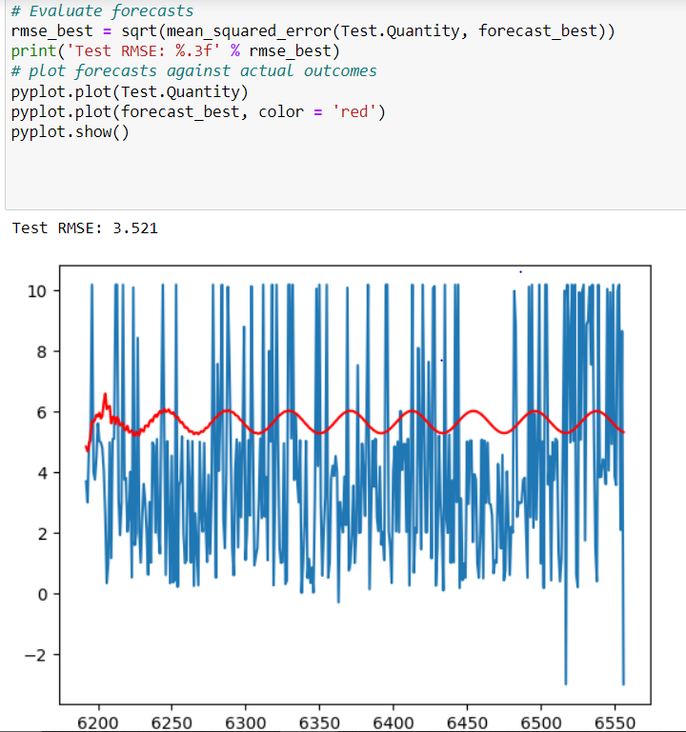
Model Building

Slide 30
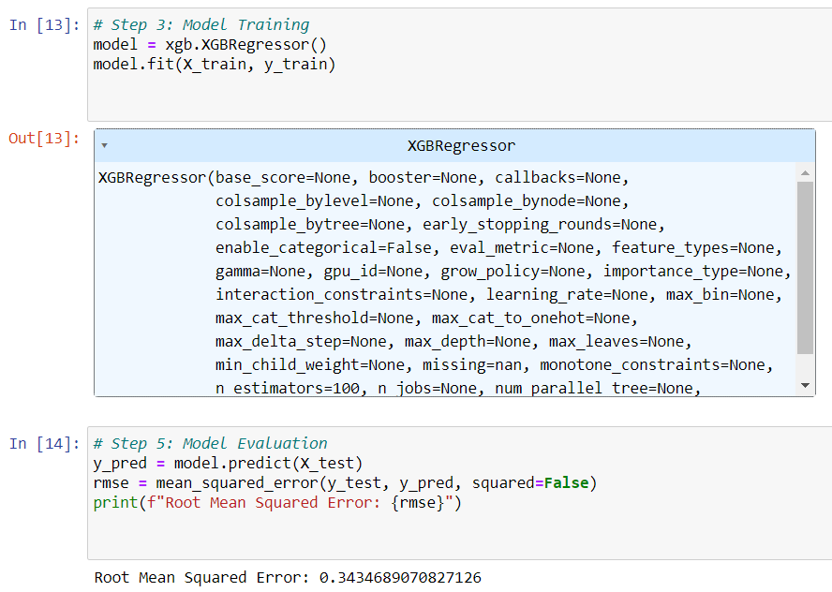
Model Building
XgBoost Model

Slide 31
Accuracies for all models
Models-Builded | RMSE Value
Linear | 3.155
Exponential | 3.510
Quadratic | 3.144
Additive seasonality | 3.158
Multiplicative seasonality | 3.348
Additive seasonality quadratic trend | 3.156
Multiplicative seasonality linear trend | 41.160
ARIMA | 3.521
XgBoost | 0.343
Models-Builded | MAPE Value
Simple Exponential Method | 3.548
Holt’s method | 67.91
Holt’s winter exponential smoothing with additive seasonality and additive trend | 3.36
Notes:
Why Random Forest Regression is good?
A Random Forest Regression model is powerful and accurate. It usually performs great on many problems, including features with non-linear relationships
How is XGBoost different from random forest?
One of the most important differences between XG Boost and Random forest is that the XGBoost always gives more importance to functional space when reducing the cost of a model while Random Forest tries to give more preferences to hyperparameters to optimize the model..
n_estimators — the number of decision trees you will be running in the model

Slide 32
Best Model
In this project I'm choosing ARIMA as the Best model with test RMSE of 3.521

Slide 33
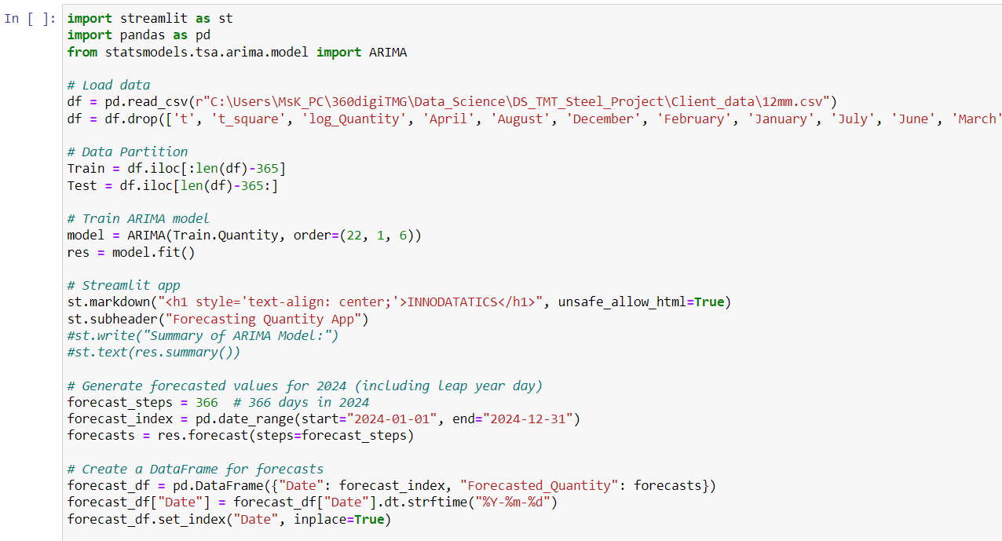
Model Deployment Strategy using Stream-Lit

Slide 34
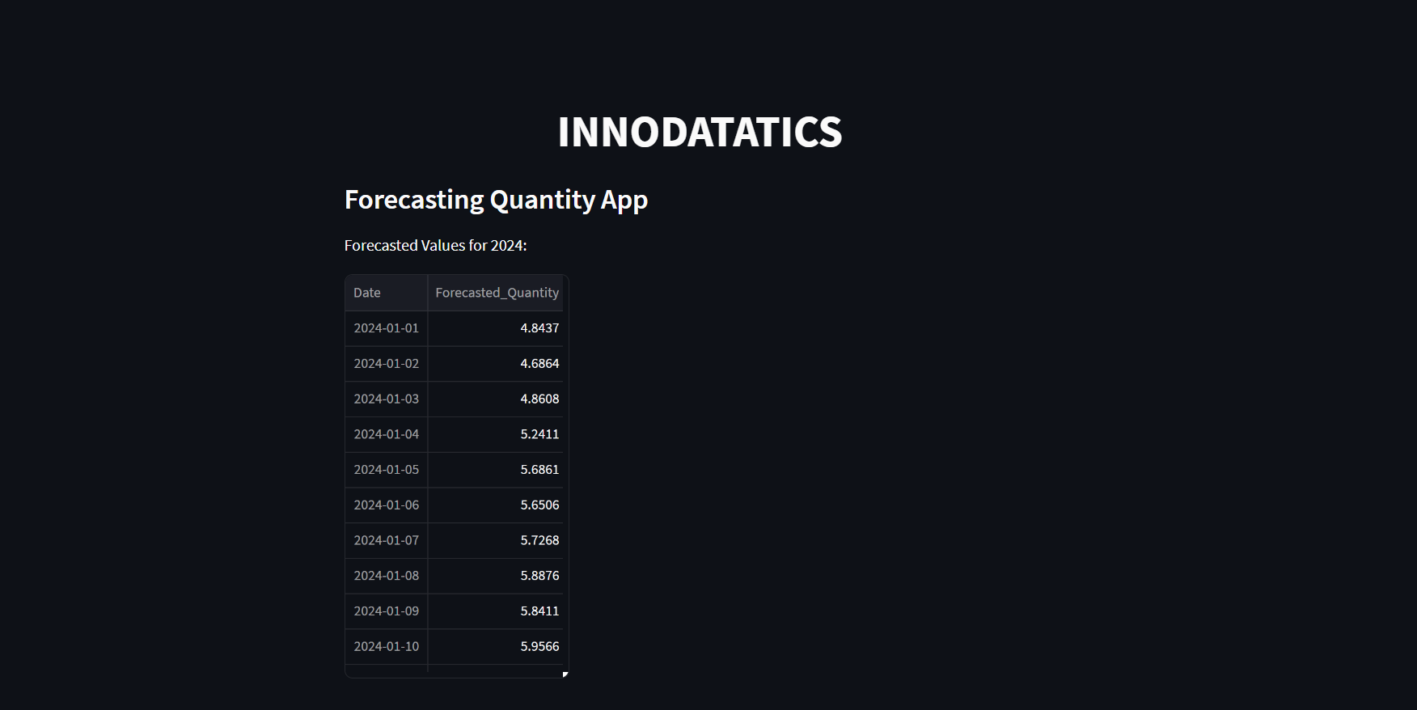
Screen shot of output

Slide 35

Video of output

Slide 36
Comprehensive video for the project
Drive link : https://drive.google.com/file/d/1bnI5GvDBGKFjHXrWOxOH7owwoAJwXEXo/view?usp=drive_link

Slide 37
Challenges
Data Availability and Quality.
Data Pre-processing.
Ethical and Legal Considerations.
Seasonal and Cyclical Patterns.
Model Complexity.

Slide 38
Future Scopes
Advanced Modeling Techniques: Exploration of more sophisticated machine learning and deep learning models that can capture intricate demand patterns and relationships within the steel industry.
Real-time Forecasting: Developing real-time forecasting capabilities that provide up-to-the-minute predictions to adapt to rapidly changing market conditions.
Predictive Analytics Tools: Creation of user-friendly tools that allow industry professionals to generate accurate steel rod quantity forecasts without in-depth technical expertise.
Risk Assessment: Incorporating risk assessment and uncertainty quantification into forecasting models to provide a more holistic view of potential outcomes.

Slide 39
Future Scopes
AI-driven Decision Support: Development of AI-powered decision support systems that help in making informed choices based on forecasted steel rod quantities.
Continuous Learning Models: Building models that can adapt and self-improve over time as new data becomes available, leading to continuously enhanced accuracy.
Ethical AI Considerations: Addressing ethical concerns related to data privacy, bias, and fairness as AI-driven forecasting becomes more pervasive.
Industry Collaboration: Encouraging collaboration between academia, research institutions, and the steel industry to develop tailored forecasting solutions.

Slide 40

Queries ?

Slide 41


